Slide 1
CIS 490H/590J Edge Computing
Edge and Fog
Winter 2023
Prof. Zheng Song
zhesong@umich.edu

Slide 2
Outline
Edge Computing Overview: From X to Edge:
X1 = CDN
X2 = ISP (RAN)
X3 = IOT
Edge Computing Platforms provided by AWS
Demonstration

Slide 3
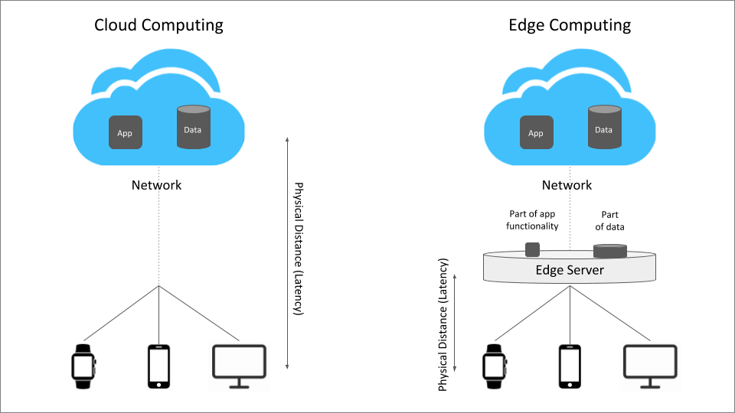
Edge Computing
Edge Computing:
Cloud: transmit data to central network for processing
Edge: put processing power to the edge of the network near data source
Notes:
Everyday, we use mobile apps, desktops, smart home devices, and other IoT devices to generate huge amount of data. However, these devices may not have enough computing resources to process these data.
So, we have two different solutions. Cloud computing means to push data to the cloud data center, where there are sufficient processing power. On the contrary, edge computing means to pull the computing resources to the edge of the network, near the data source.

Slide 4
Edge Systems
Functionalities:
Computing: Data Processing
Sensing & Control: IoT
Communication
Storage
...
To whose benefit
Edge-based devices
Cloud-based users
Where the processing takes place:
Edge only;
Edge & Cloud;
Edge, Fog, & Cloud;
Edge & Nearby Edges
What devices can be used:
pre-deployed edge servers
any available devices
Notes:
Next, we are going to talk about existing edge systems. Now it is still the very early stage of edge computing, and there has been various system models for edge computing. These system models answer the following questions differently. For example, some systems think edge computing is only for data processing, while some systems think it can support sensing, communication, storage, and other functionalities. Some systems think edge computing should serve edge devices, while some think it should provide data processing results to cloud-based users. Some systems think edge computing should leverage only edge devices, while some think it can use both edge and cloud, and some think edge computing involves edge, cloud, and all networking devices between them. Some systems think edge computing are provided by pre-deployed edge servers, while some think it can leverage all available devices in the vicinity.

Slide 5
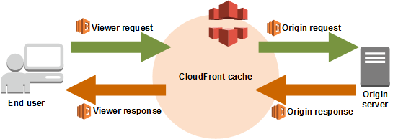
From CDN to Edge Computing
Amazon Cloudfront
One of the most widely used CDN (content distribution network)
Beta launch: Nov 2008

Slide 6
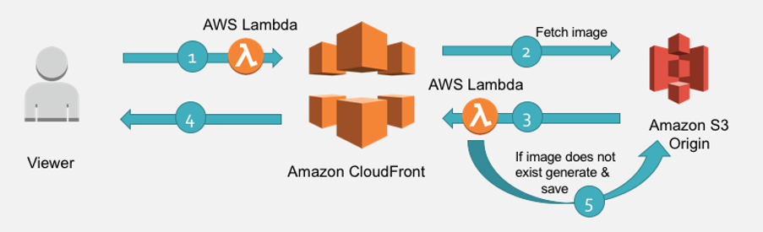
From CDN to Edge Computing
Cloudfront Lambda@Edge
First Launched in Dec 2016
10 minutes reading: https://aws.amazon.com/blogs/networking-and-content-delivery/resizing-images-with-amazon-cloudfront-lambdaedge-aws-cdn-blog/
Lambda 1: Request Redirect
Lambda 2: Image Resizing

Slide 7
Lambda@Edge Funcs
Function 1: URL redirection
/images/image.jpg?d=100*100 => /images/100x100/webp/image.jpg
Function 2: Resize Image
S3.getObject({ Bucket: BUCKET, Key: originalKey }).promise()
// perform the resize operation
.then(data => Sharp(data.Body)
.resize(width, height)
.toFormat(requiredFormat)
.toBuffer()
)

Slide 8

From CDN to Edge Computing
Akamai
EdgeSuite ESI: The ESI language is an XML-based markup language that provides the tools to assemble the content dynamically on Akamai’s network.
EdgeWorkers (Similar to Lambda@Edge Functions)
References: EdgeWorkers:https://techdocs.akamai.com/edgeworkers/docs/create-the-hello-world-code-bundle-1
EdgeSuite ESI: https://www.akamai.com/content/dam/site/zh/documents/technical-publication/akamai-esi-developers-guide-technical-publication.pdf

Slide 9
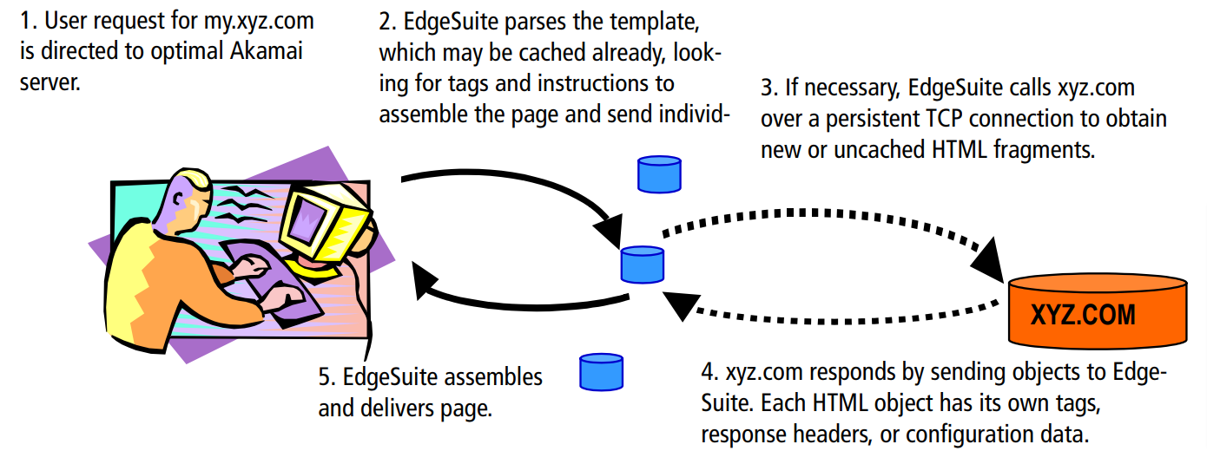
From CDN to Edge Computing
Akamai ESI
Notes:
Similar to PHP, but it also considers location and availability of resources.

Slide 10
From CDN to Edge Computing
Akamai ESI
<html>
<body>
Today is <esi:vars>$strftime($time(), '%A %B %d, %Y')</esi:vars><br>
<esi:include src="viewsource.html?rp=$(REQUEST_PATH)"/>
</body>
</html>
Q: how is it different from Markup Languages like PHP?
<esi:include src= "http://example.com/1.html" alt= "http://bak.example.com/2.html" onerror= "continue" />
Notes:
Context awareness

Slide 11
From CDN to Edge Computing
Cloudfront:
450+ nodes (including Detroit) in 2023
Edge nodes
Regional edge caches (hierarchical)
240 nodes in 2022, 61 in US (closest to MI --- IL)
200 nodes in 2019, distributed in 77 cities
Akamai (CDN → Edge Computing):
4200 locations (2020 ~ 2023)

Slide 12
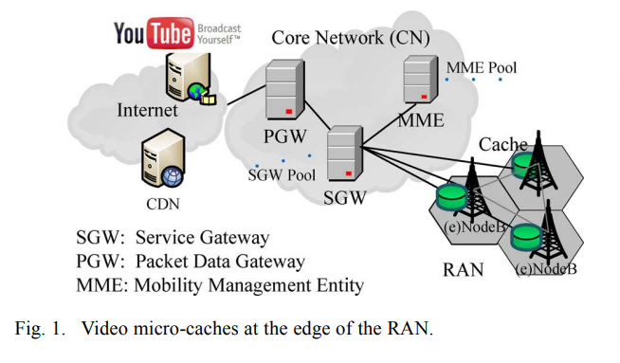
From ISP (RAN) to Edge
RAN: Radio Access Network (3G, 4G, 5G…)
Features of base stations?
Dumb devices
Limited processing power
Wide coverage
Good only for simple tasks (cache)

Slide 13
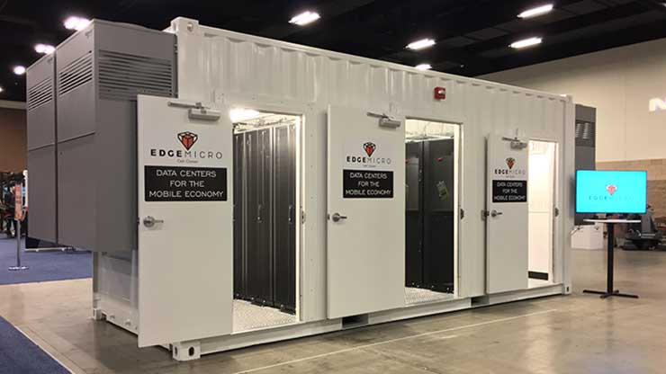
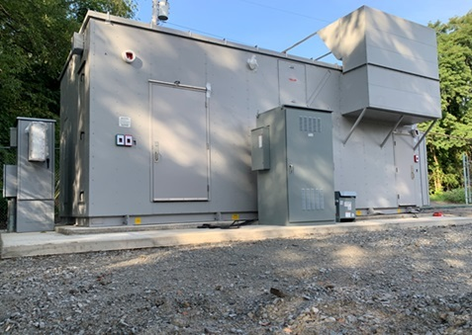
From ISP to Edge Computing
More powerful base stations: Micro Data Centers at Base Stations
mini data center by EdgeMicro and Vapor [ Bankrupted, why? ]
Notes:
Went bankrupt because not enough users.
The feeling is that in order to realize edge computing in its greater form is to use hierarchical edge computing infrastructure.
Aka: Fog Computing

Slide 14
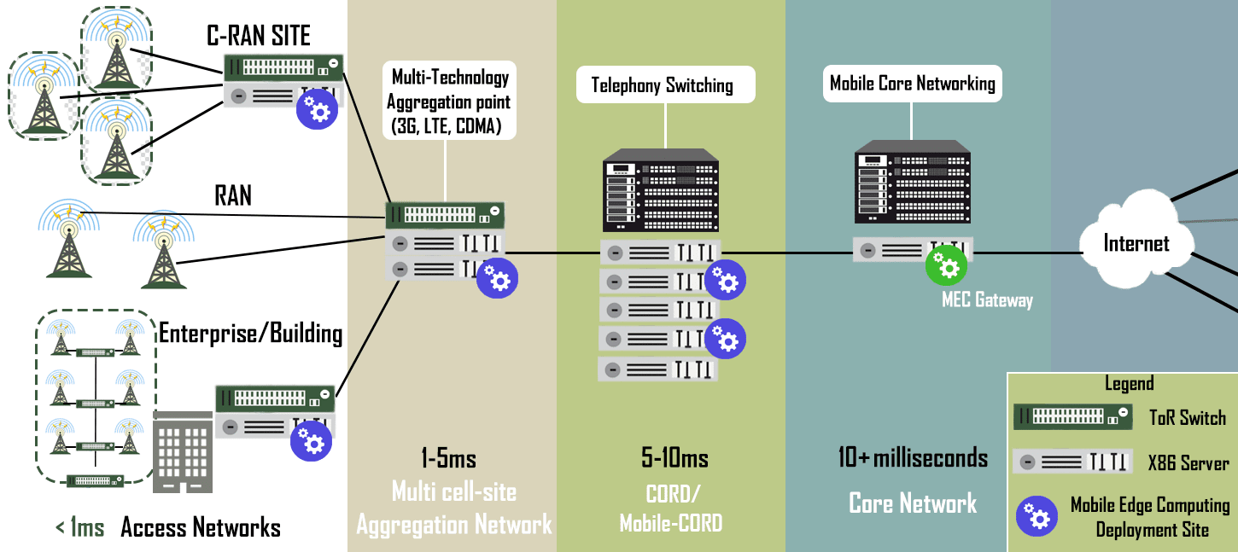
From ISP to Edge Computing
Cloudpath: A multi-tier cloud computing framework ⇒ Fog Computing
fog computing facilitates the operation of compute, storage, and networking services between end devices and cloud computing data centers.
Notes:
Professor believes this will be the path forward to the future of edge computing, especially since ISPs already have a hierarchical network infrastructure in place already that functions in such a way that edge computing would need to mimic in many ways.

Slide 15
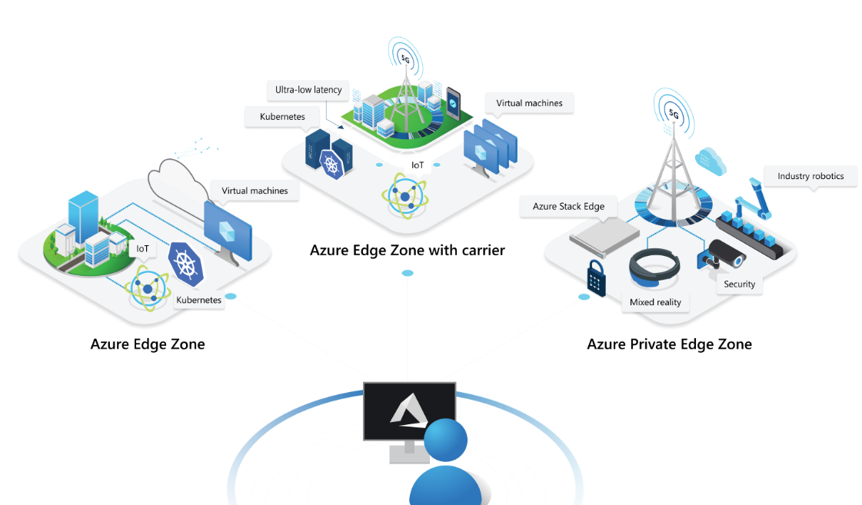
From [ISP+ Cloud] to Edge
Microsoft + AT&T
Private Edge on 5G

Slide 16
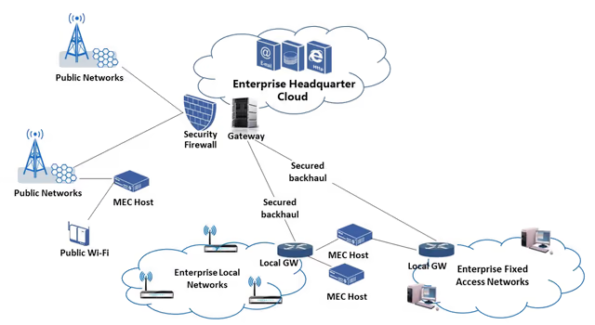
From [ISP+ Cloud] to Edge
AWS + Verizon: Private Edge on 5G access network (for business)

Slide 17
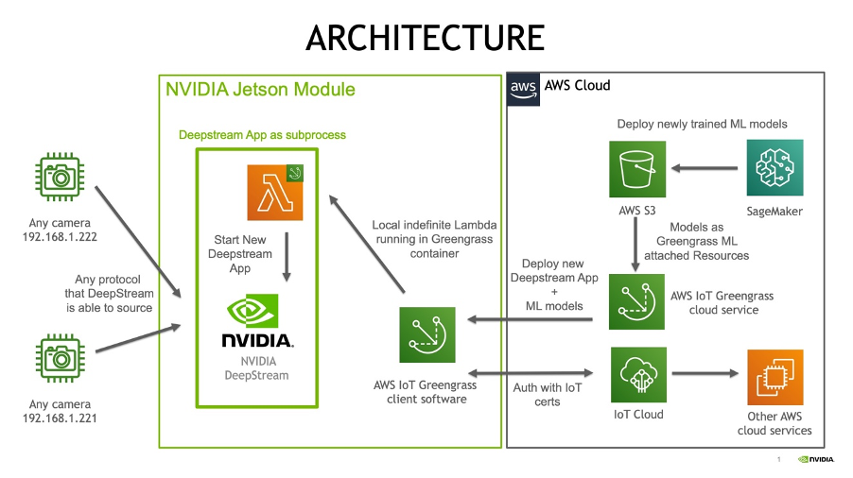
From IoT (smart home vendors) to Edge
AWS Greengrass

Slide 18
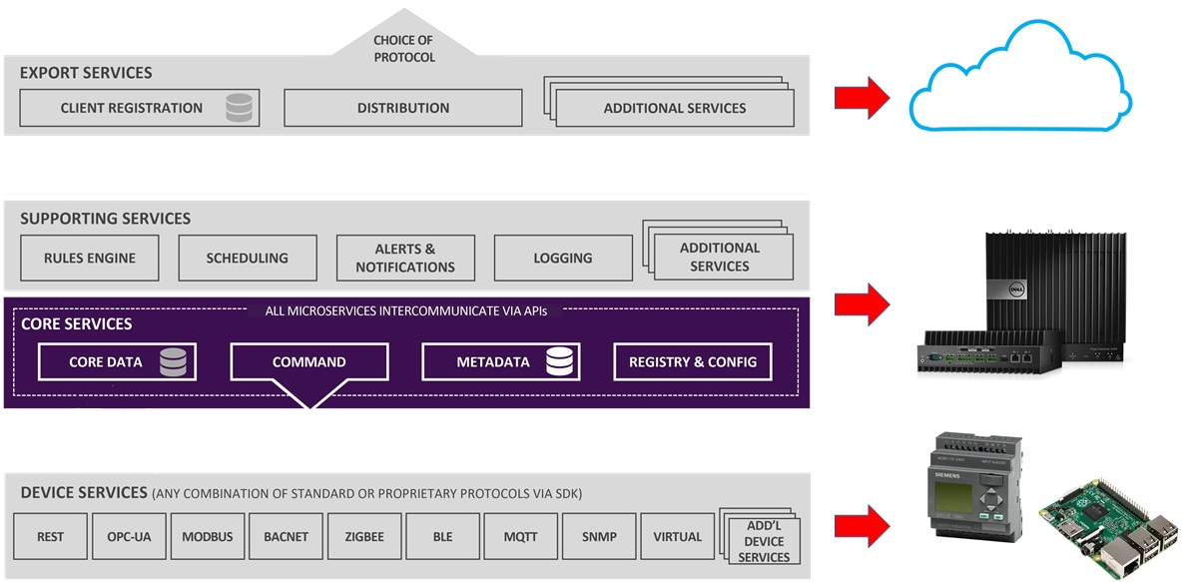
From IoT to Edge
EdgeX Foundry (hosted by Linux Foundation)

Slide 19
From IoT to Edge
Common Features of AWS Greengrass and EdgeX
IoT data aggregate at cloud
Use edge devices for data processing
Support heterogeneous edge/IoT devices
Flexibly decide: what runs best where?

Slide 20
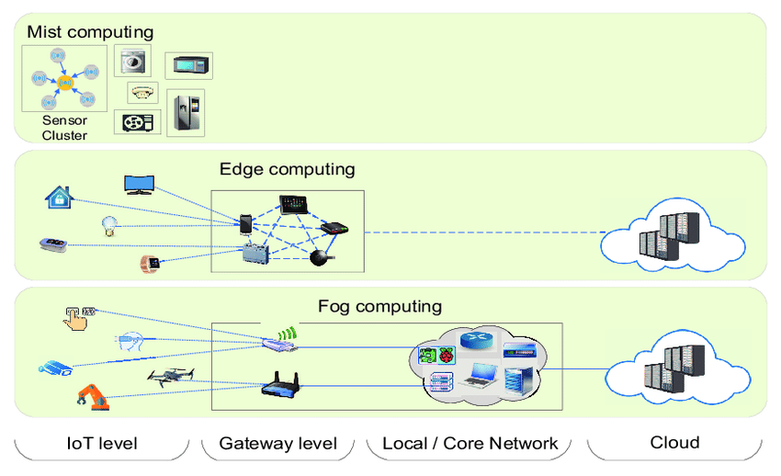
Mobile Ad-hoc Edge (Self-organized Edge, Mist Computing)
How is it different from ISP private edge computing?
No network needed
Lower cost
Heterogeneous

Slide 21
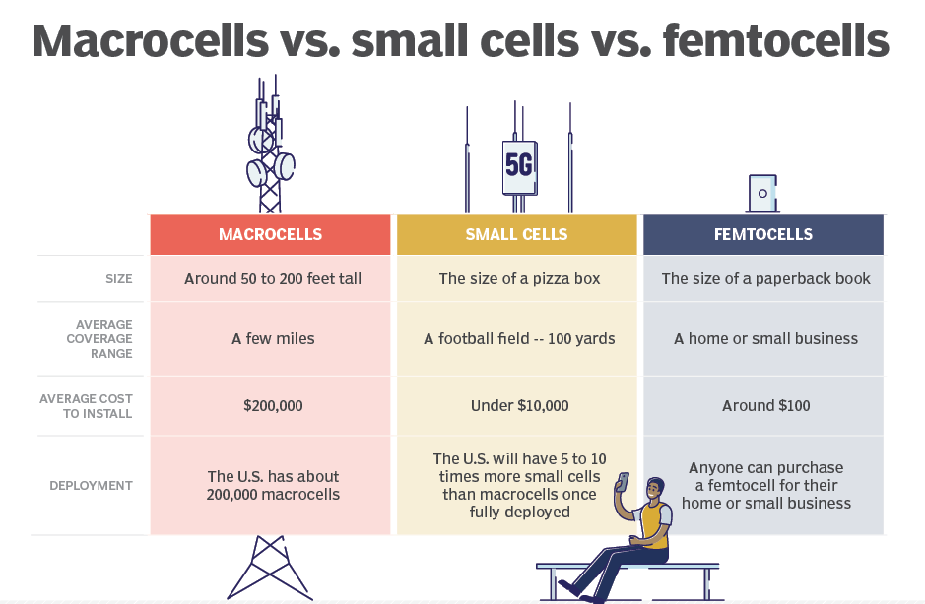
Usually Requires a Coordinator
Femto Cell: low-power wireless base station for providing cellular access in areas with limited or no cellular provider
Notes:
https://www.lanner-america.com/blog/multi-access-edge-computing-future/

Slide 22
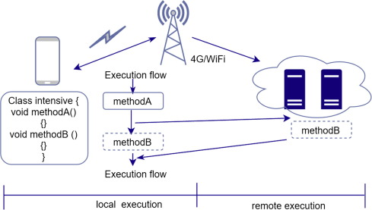
From Offloading to Edge Computing (Cloudlet)
Mobile Offloading
Move VM checkpoint
Move .class file (Android)
Download from registry
Moving data/executables

Slide 23
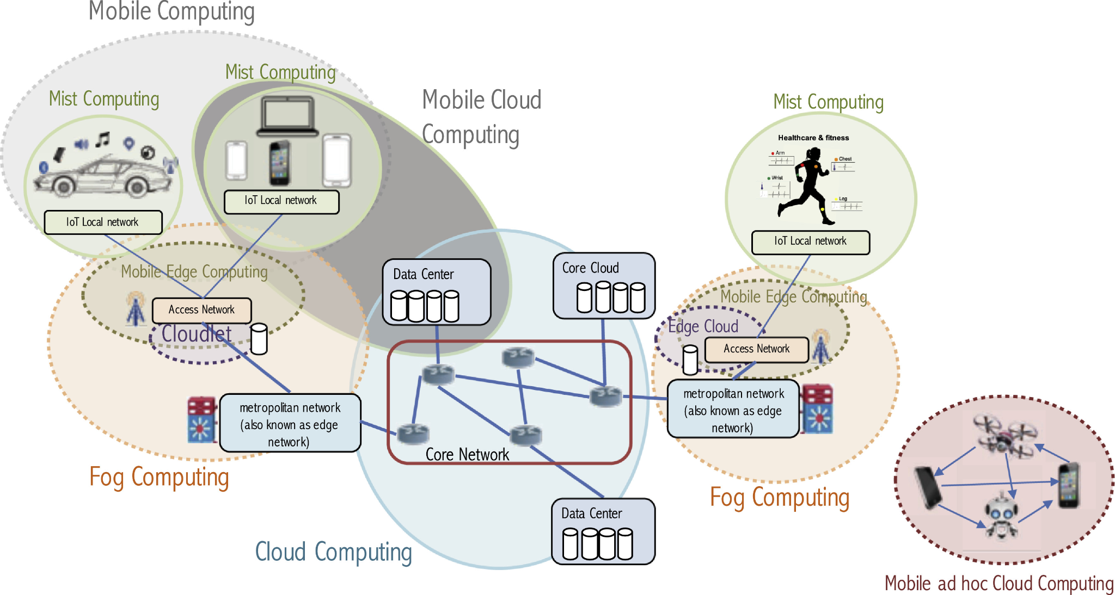
Summary
IoT-Edge
ISP-Private
ISP-Edge
Self-Organized Edge
Cloud-Edge

Slide 24
Think about:
In the above mentioned edge system models (cloud, ISP, ISP-private, IoT, self-organized),
Which ones have the most resources?
Which ones have the least latency?
Which ones are more manageable?
Which ones are the least manageable?
Notes:
Professor thinks ISP provides the most balance among the above questions and thus he thinks it will be the future.

Slide 25
2. AWS’s Edge Computing Products
Cloudfront
Snow Family
Outpost family
Wavelength/Local Zones
Greengrass
Why Amazon invested so much on edge computing?
https://d1.awsstatic.com/IoT/IDC-AWS-at-the-Edge-White-Paper.pdf (Dec 20)
By 2023 70% enterprises will run data processing at IoT Edge
By 2024, 800% increase in the number of apps at the edge

Slide 26
2.1 Cloudfront
Edge Function provided as Web Service
HTTP Post Parameters ⇒ Processing ⇒ HTTP Output
Who provide the computing hardware?
Who benefit from such edge computing?
Who develop edge computing software?

Slide 27
2.1 Cloudfront
Edge Function provided as Web Service
HTTP Post Parameters ⇒ Processing ⇒ HTTP Output
Who provide the computing hardware? [AWS, Edge Computing Infrastructure]
Who benefit from such edge computing? [end users like us]
Who develop edge computing software? [website owners]

Slide 28
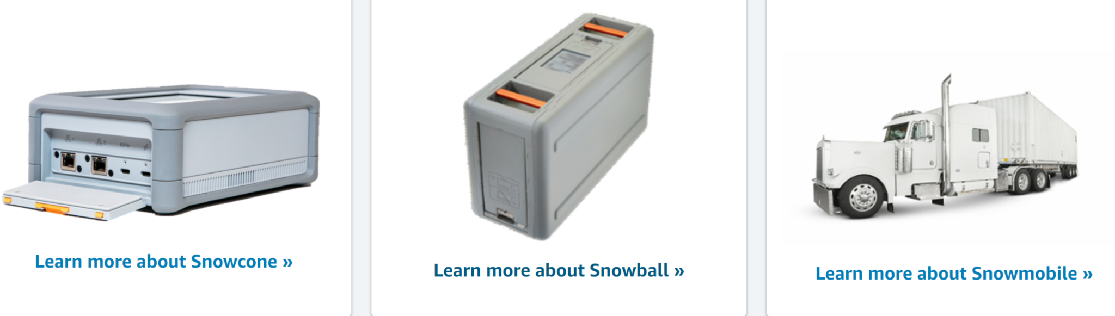
2.2 Snow Family
Snowball, Snowmobile
Primary usage: moving data (a giant USB-drive)
Accept AWS APIs for data processing (think of it as an isolated EC2)
Snowcone/Snowball: can also run IoT GreenGrass

Slide 29
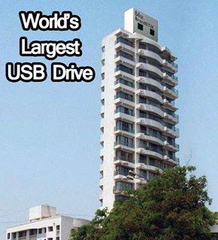
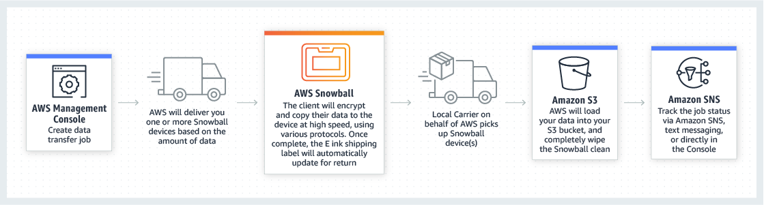
2.2 Snow Family

Slide 30
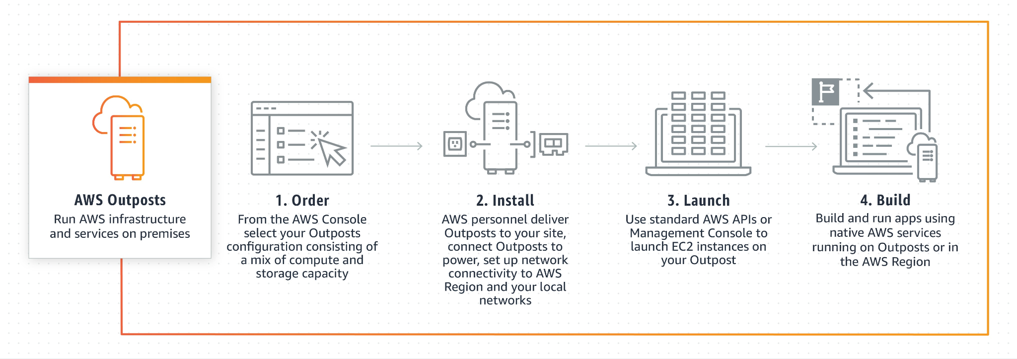
2.3 Outpost
AWS Outposts is a family of fully managed solutions delivering AWS infrastructure and services to virtually any on-premises or edge location for a truly consistent hybrid experience. [in house AWS]

Slide 31
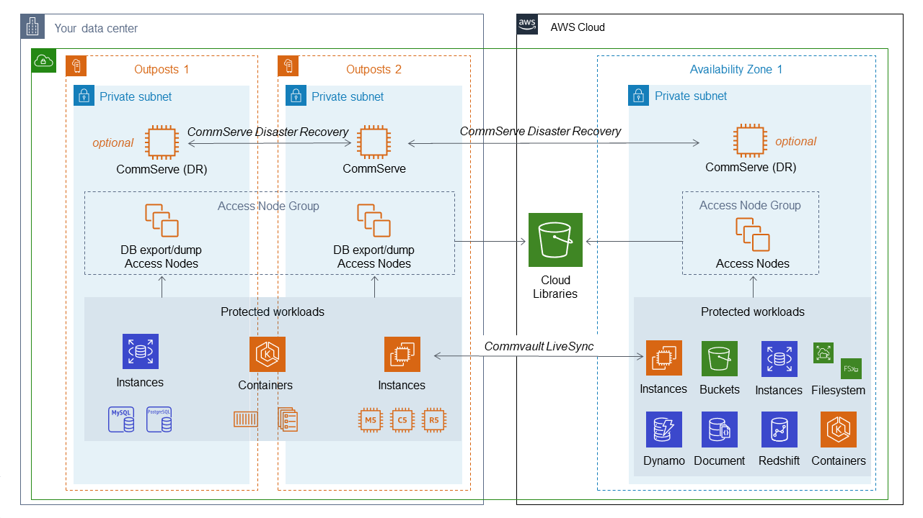
2.3 Outpost
Outposts provides localized EC2, EBS, RDS, EKS and more recently S3 services within Amazon managed racks. It works with Commvault to provide cloud-native backup and failure recovery.

Slide 32
2.4 Wavelength
AWS Wavelength is an infrastructure offering optimized for mobile edge computing applications. Wavelength Zones are AWS infrastructure deployments that embed AWS compute and storage services within communications service providers’ (CSP) 5G networks, so application traffic from 5G devices reach application servers running in Wavelength Zones without leaving the telecommunications network.
Outpost that you share with other users.

Slide 33
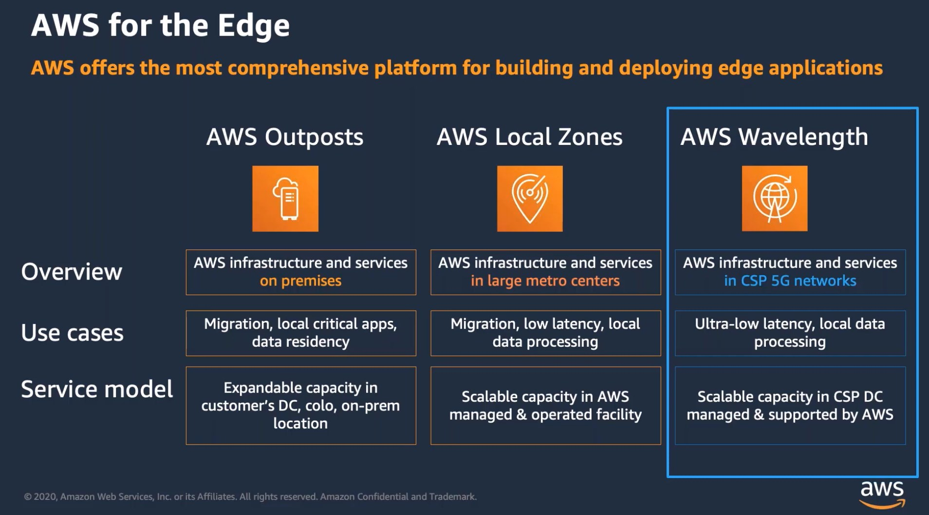
2.4 Wavelength

Slide 34
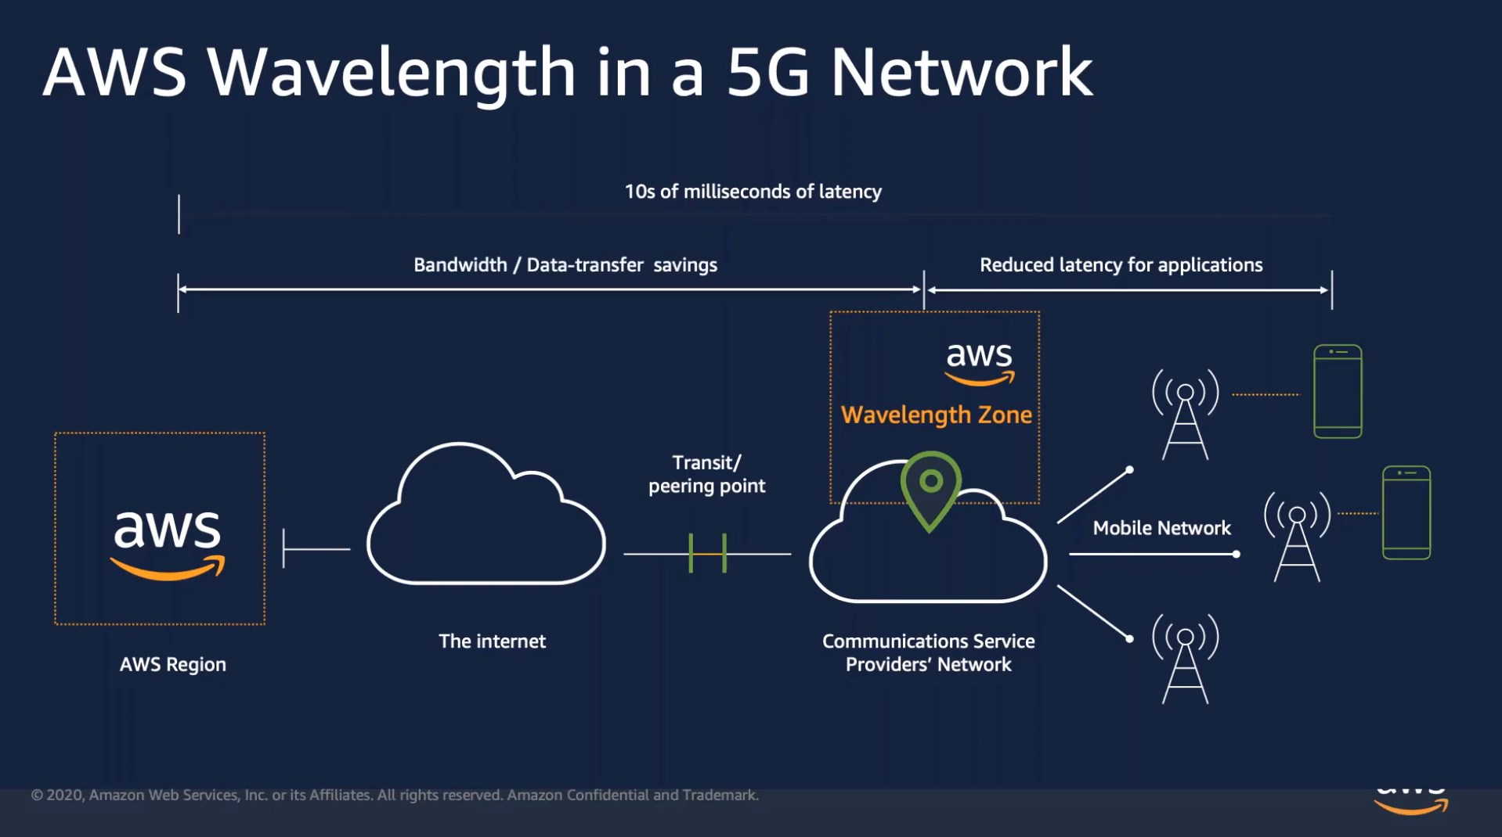
2.4 Wavelength

Slide 35
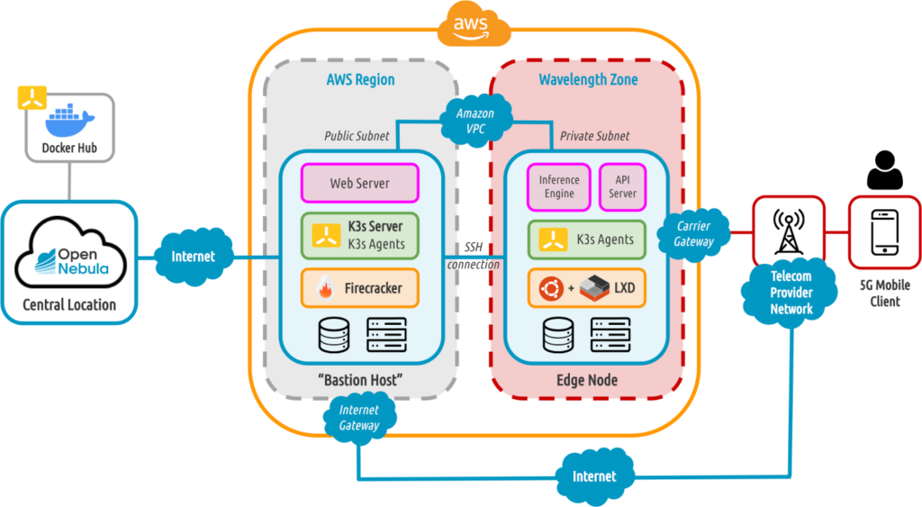
2.4 Wavelength
Select a AWS region (Virginia)
Create Virtual Private Cloud (a private subnet that connects cloud/edge)
Launch an EC2 instance in Wavelength Zone

Slide 36
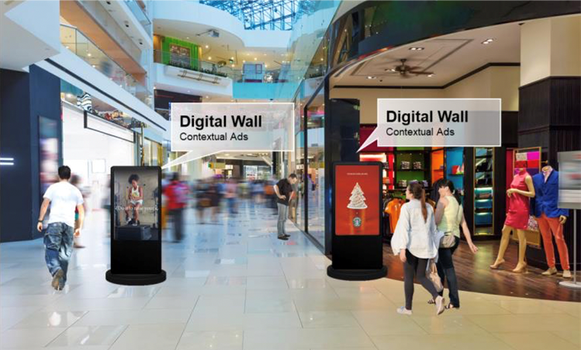
2.4 Wavelength
Application example (given by AWS)
hyper-personalized ads in the retail space

Slide 37
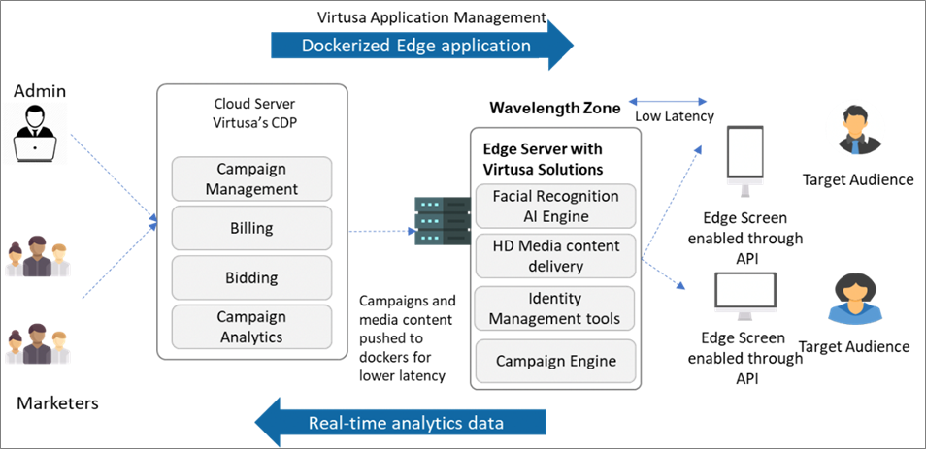
2.4 Wavelength
Not all applications are deployed in wavelength (only the latency sensitive app)

Slide 38
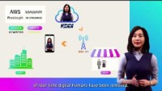
Wavelength

Slide 39
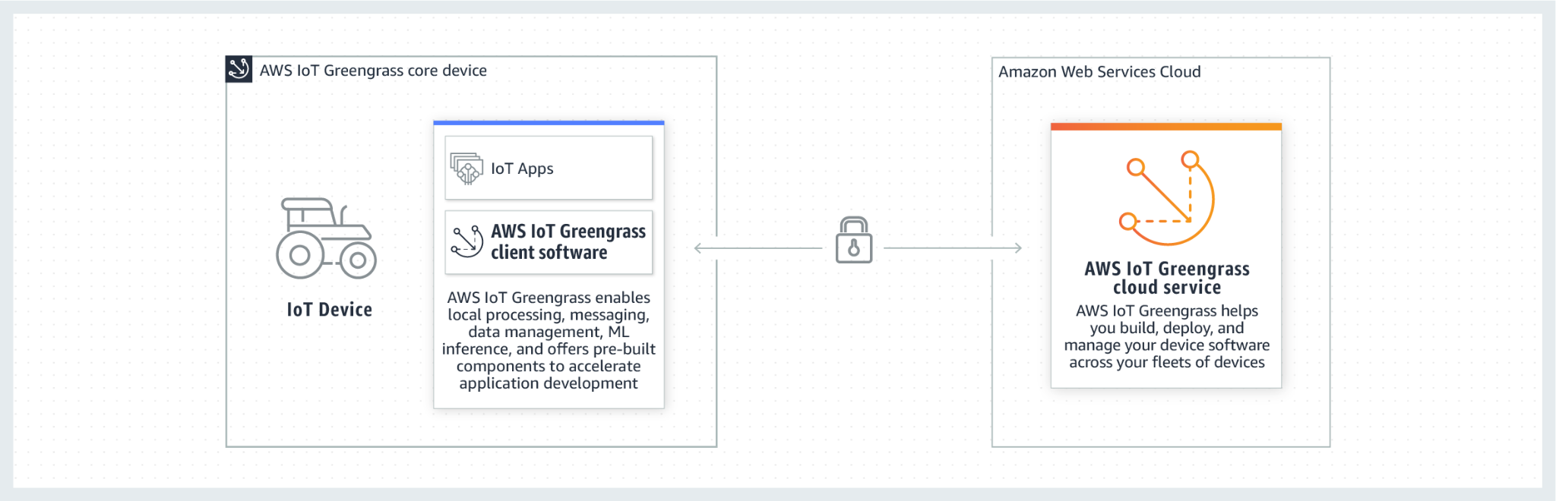
2.5 Greengrass
Deployed on powerful IoT devices (Greengrass core device) for data processing

Slide 40
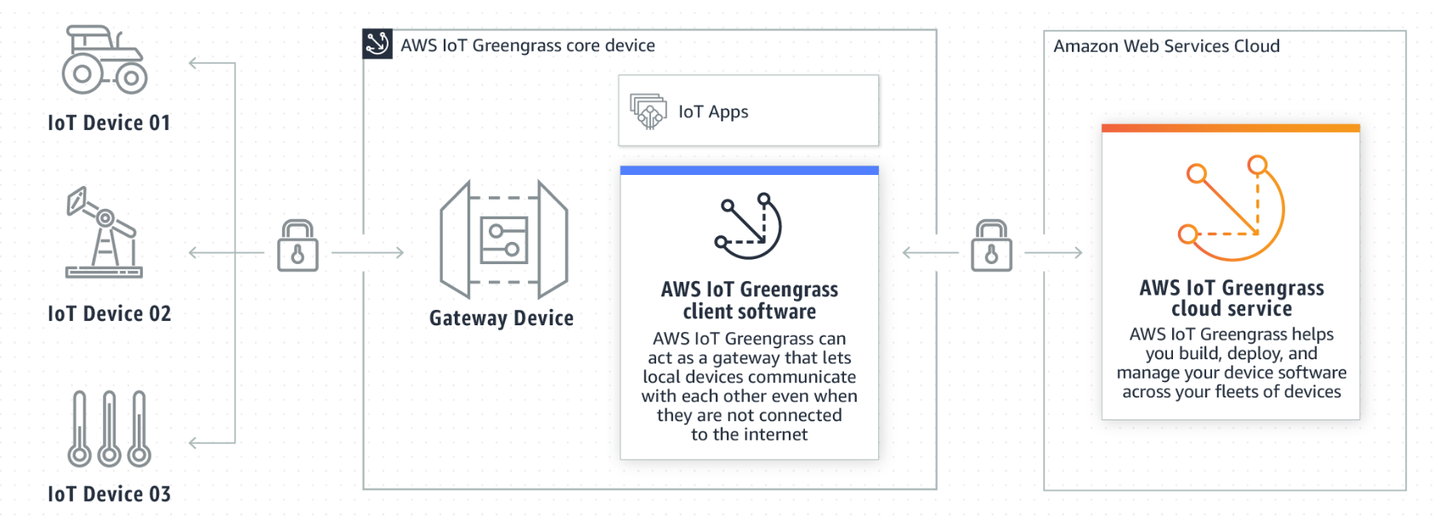
2.5 Greengrass
2. IoT devices can vary in size, ranging from smaller microcontroller-based devices to large appliances. AWS IoT Greengrass Core devices, AWS IoT Device SDK-enabled devices, and FreeRTOS devices can be configured to communicate with one another. If the AWS IoT Greengrass Core device loses connectivity to the cloud, connected devices can continue to communicate with each other over the local network.
IoT core device acts as an edge server for less capable IoT devices (IoT Device SDK / FreeRTOS)

Slide 41
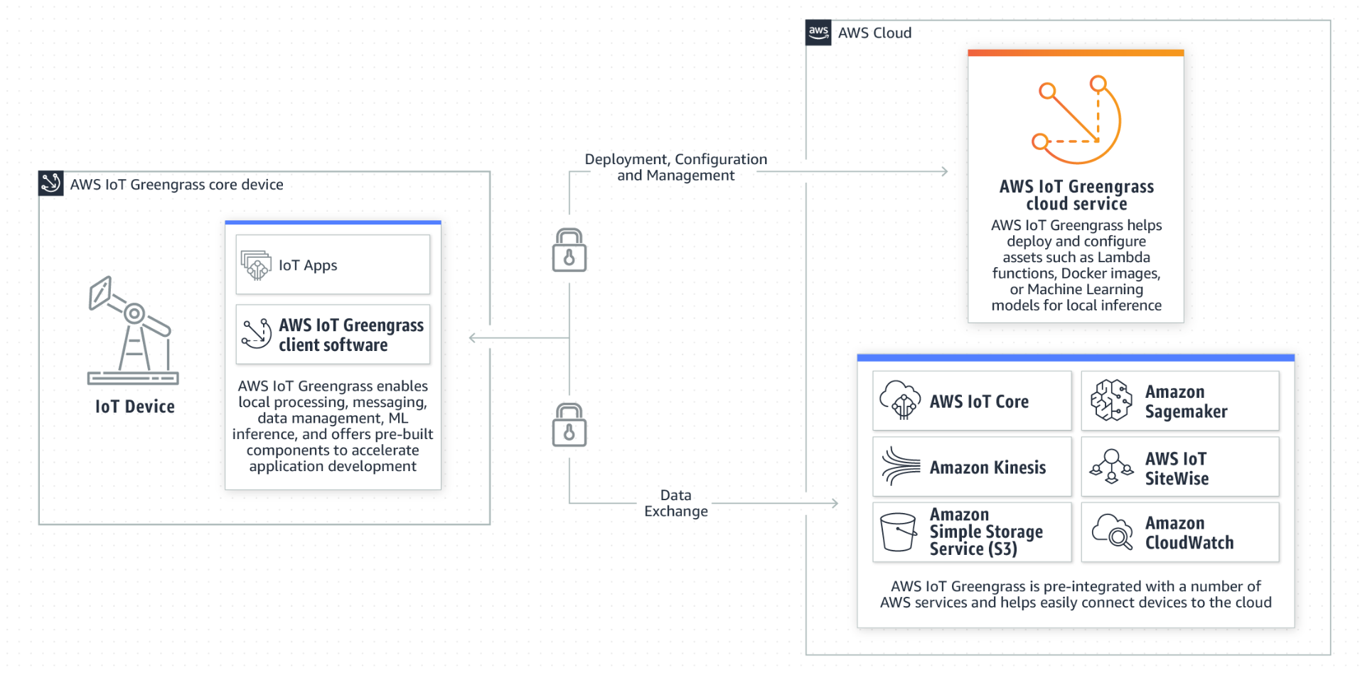
2.5 Greengrass
3. AWS IoT Greengrass provides pre-built components so you can easily extend edge device functionality without writing code. AWS IoT Greengrass components enable you to add features, and quickly connect to AWS services or third-party applications at the edge.

Slide 42
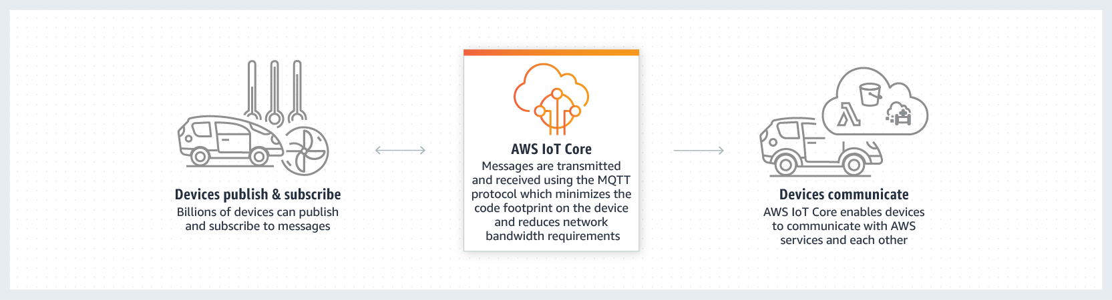
2.5 Greengrass
Related Modules: 1. IoT core (MQTT Broker Integrated with AWS authentication)

Slide 43
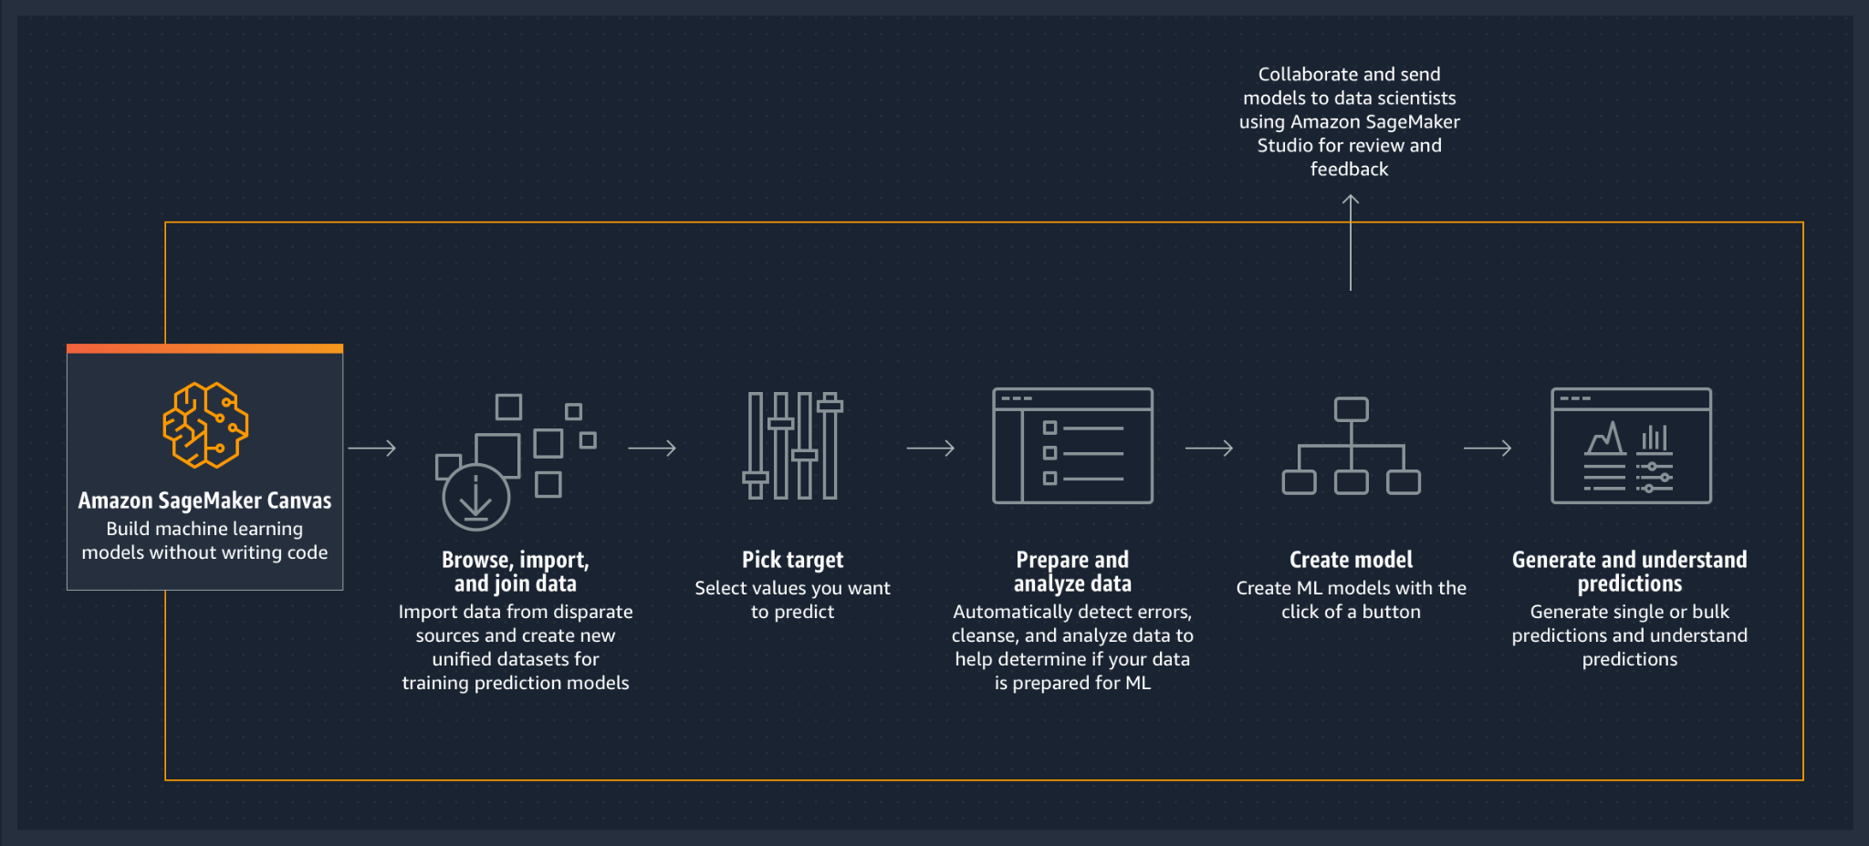
2.5 Greengrass
Related Modules: 2. SageMaker (integrated ML platform/module/data interface)

Slide 44
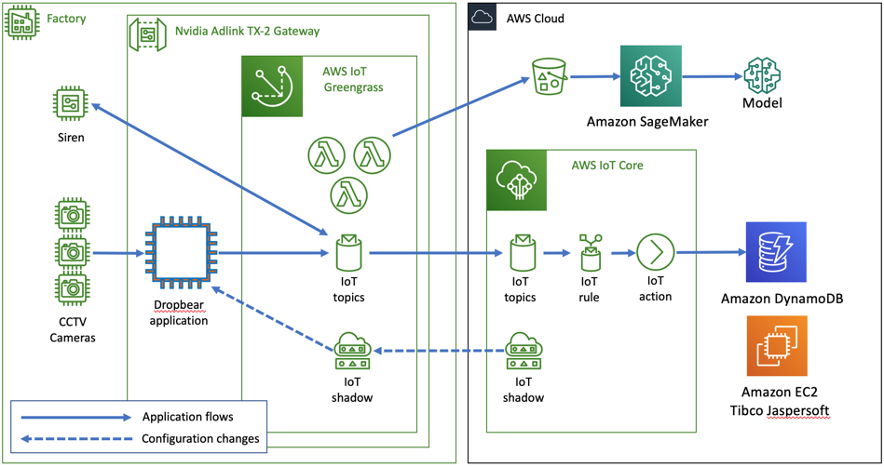
2.5 Greengrass Usage Example
CCTV cameras placed around infrastructural settings
Edge gateway to analyze, report on, and alert operators about unexpected inputs, increasing industrial safety at the edge.
Dropbear: image capture, object detection
tracking, and depth analysis of streams
use IoT SDK to comm. with Greengrass.
Use AWS SDK to transfer image to S3.
https://aws.amazon.com/blogs/iot/improving-industrial-safety-with-video-analytics-aws-iot-core-and-aws-iot-greengrass/
Notes:
alerts and sirens can be triggered locally from AWS IoT Greengrass with mere milliseconds of latency

Slide 45
2.5 Greengrass
Bigmate initially developed the platform on standalone NVIDIA Jetson TX-2 Edge Gateways, but they quickly realized that this approach would be difficult to manage at scale across multiple facilities, edge gateways, and cameras. To enable easier scaling, they built their platform management functionality using AWS Lambda functions running locally inside AWS IoT Greengrass. This enabled the following benefits:
Unattended deployment of software and configurations across many environments, without the need for a developer to work onsite.
Direct from-the-edge integration with AWS services such as Amazon S3 to collect image samples and improve image classification model training.
The use of Amazon SageMaker to expedite improvement and deployment of AI models to the edge, which also expands the captured scenarios that populate the object detection library.
Why choosing AWS? [mature programming framework, toolchain for everything]

Slide 46
Comparison of all AWS product related to edge computing
 | CloudFront | Snowball | Outpost | Wavelength | Greengrass
Key feature | web | storage | computing | 5G network | IoT
what? | AWS infras. | Dedicated Device | Dedicated Device | AWS infras. | Your own IoT devices
share? | Yes | No | No | Yes | No
Client? | User at edge | Cloud user | User at edge | User at edge | both
Work with cloud? | Yes | No | Kind of | Yes | Yes

Slide 47
2. AWS’s Edge Computing Products
Quiz: what AWS’s Edge Product should be used in the following usage scenario?
Active Migration and Transportation of Large data
Low-Latency sensitive Gaming applications
Smart Farm
Assembly line data analysis for Ford
Spotify’s new service: happy birthday song personalized with your name
 | CloudFront | Snowball | Outpost | Wavelength | Greengrass
Key feature | web | storage | computing | 5G network | IoT
what? | AWS infras. | Dedicated Device | Dedicated Device | AWS infras. | Your own IoT devices
share? | Yes | No | No | Yes | No
Client? | User at edge | Cloud user | User at edge | User at edge | both
Work with cloud? | Yes | No | Kind of | Yes | Yes

Slide 48
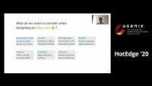
Sharing and Caring of Data at the Edge

Slide 49
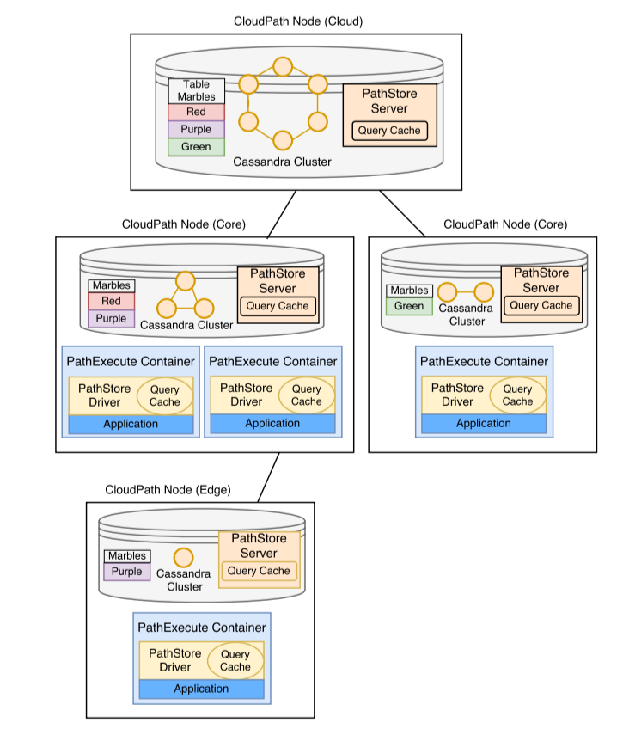
CloudPath (SEC’17)
Multiple tier storage: cloud, path, edge
On-demand replication:
Request data from parent nodes
Leaf contains a subset of data
3. Update propagation:
Eventual consistency: error happens

Slide 50
Discussion on Edge-based Caching/Data sharing
Caching, data sharing, data processing: three different aspects.
2. In my perspective, edge-based caching is most beneficial for small-size data transmission. When transmitting a video or a ML model of 100MB, using edge or not does not make too much of a difference, given the long data transmission latency.
3. Data processing:
transmit: lambda_3[lambda_1(raw data1), lambda_2(raw data2)]
router 1: lambda_3[processed_data1, lambda_2(raw data2)]
router 2: lambda_3[processed_data1, processed_data2]
…

Slide 51
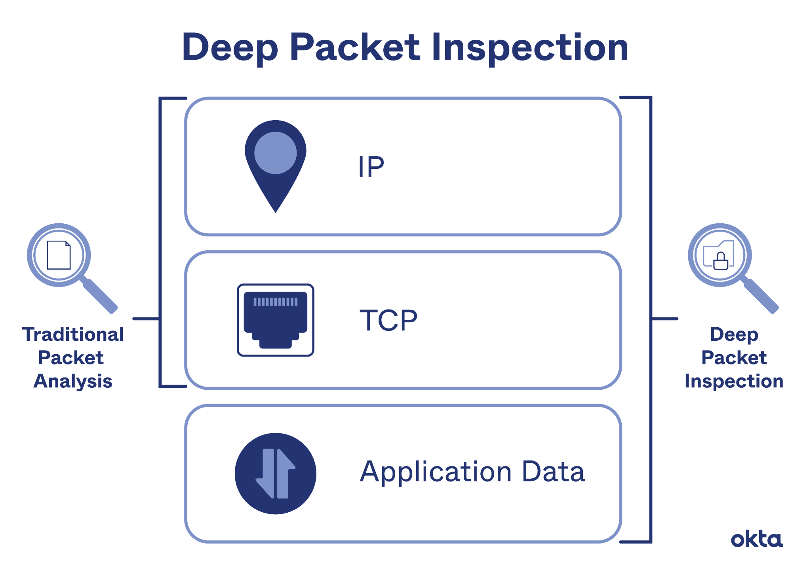
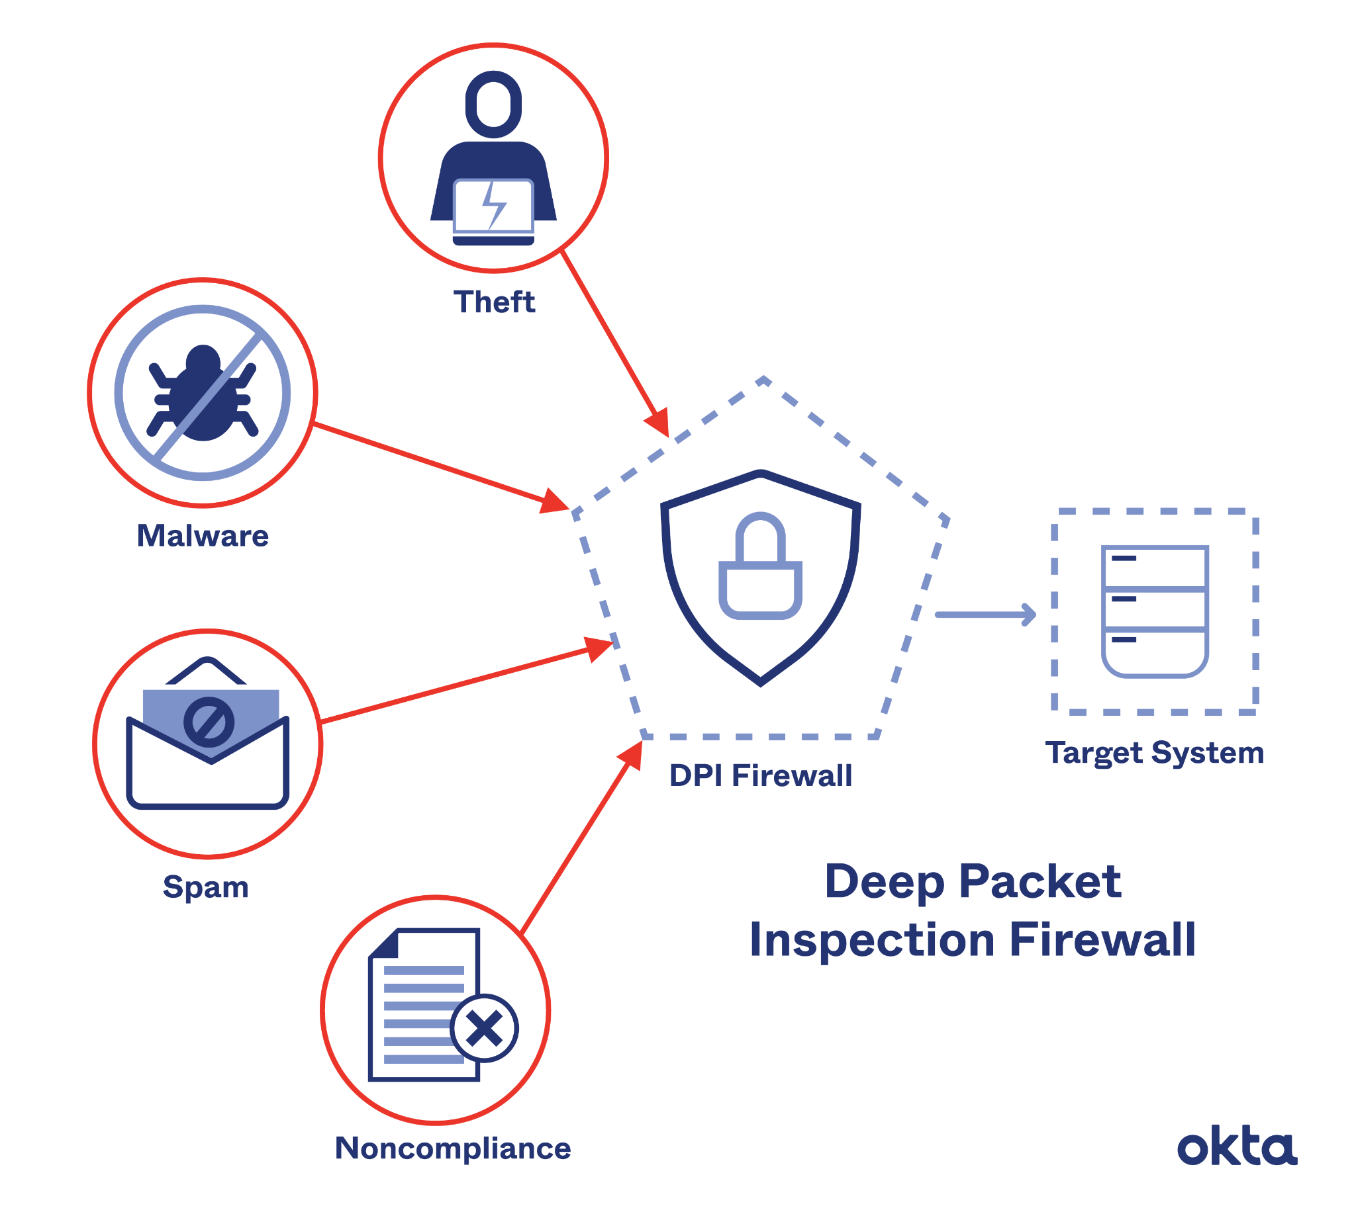
How to query edge-base caching?
DPI: Deep package inspection (no longer popular with HTTPS)

Slide 52
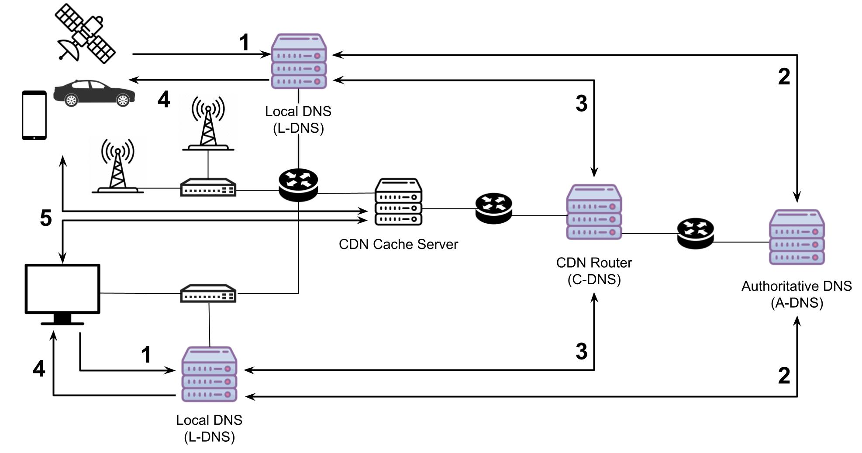
How to query edge-base caching?
2. DNS-based approach (authoritative DNS server-based routing)

Slide 53
How to query edge-base caching?
3. Delegation
Client → caching system (prefetching system)
If hit: return results
Else:
Caching system sends the request for the client
Return the results to the clients
Q: Why it is still beneficial? Energy (WiFi/public network) / repetitive requests

Slide 54
Rest of this semester:
Comparing edge/cloud
Application of edge computing in smart farm/underwater network
CAP theorem
Distributed ledger / blockchain
Federated learning
Project

